Slide 1
Defining Classes and Objects

Slide 2
Agenda
Creating an Object/ Class
Oriented programming (OOP) principles
Constructors
Encapsulation and Inheritance

Slide 3
Defining Classes
In this chapter we will understand how to define custom classes and their elements. We will learn to declare fields, constructors and properties for the classes. We will revise what a method is and we will broaden our knowledge about access modifiers and methods. We will observe the characteristics of the constructors.

Slide 4
What Does a Class Contain?
Every class contains a definition of what kind of data types and objects has in order to be described. The object (the certain copy of this class) holds the actual data. The data defines the object’s state.
In addition to the state, in the class is described the behavior of the objects. The behavior is represented by actions, which can be performed by the objects themselves. The resource in OOP, through which we can describe this behavior of the objects from a given class, is the declaration of methods in the class body.

Slide 5

Elements of the Class
Now, we will go through the main elements of every class, and we will explain them in details latter. The main elements of a C# classes are the following:
Class declaration – this is the line where we declare the name of the class, e.g.:

Slide 6
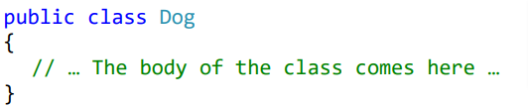
Elements of the Class
Class body – similar to the method idioms in the language, the classes also have single class body. It is defined right after the class declaration, enclosed in curly brackets "{" and "}". The content inside the brackets is known as body of the class. The elements of the class, which are numbered below, are part of the body.

Slide 7
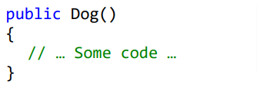

Elements of the Class
Constructor – it is used for creating new objects. Here is a typical constructor:
Fields – they are variables, declared inside the class (somewhere in the literature are known as member-variables). The data of the object, which these variables represent, and are retained into them.

Slide 8

Elements of the Class
Properties – this is the way to describe the characteristics of a given class. Usually, the value of the characteristics is kept in the fields of the object. Similar to the fields, the properties may be held by certain object or to be shared among the rest of the objects.
Methods – from the chapter "Methods" we know that methods are named blocks of programming code. They perform particular actions and through them the objects achieve their behavior based on the class type. Methods execute the implemented programming logic (algorithms) and the handling of data.

Slide 9
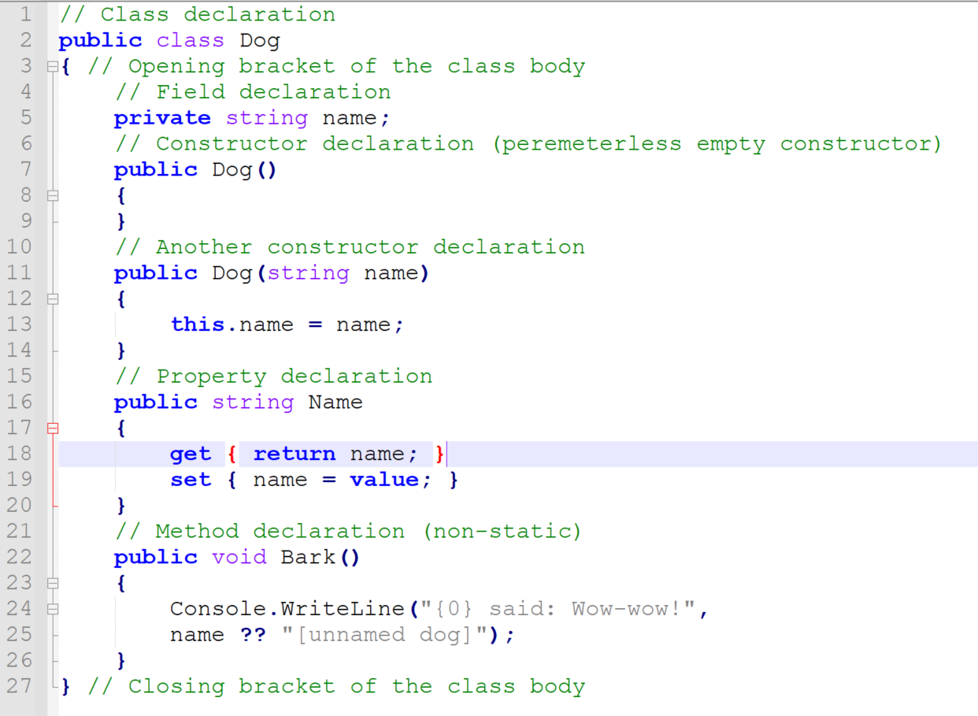
Sample Class

Slide 10
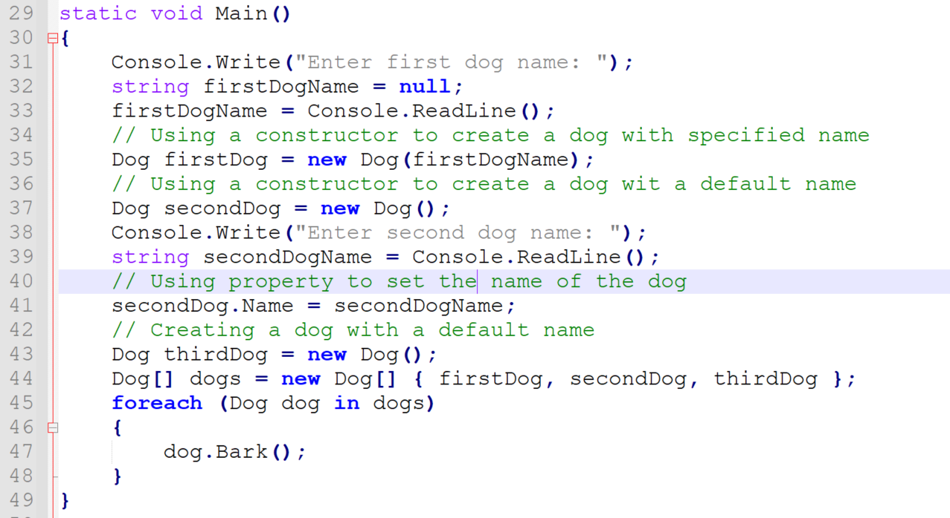
Usage of Class

Slide 11
Output from the execution
Enter first dog name: Axl
Enter second dog name: Bobby
Axl said: Wow-wow!
Bobby said: Wow-wow!
[unnamed dog] said: Wow-wow!

Slide 12
Object-Oriented Programming (OOP)
OOP is a programming paradigm based on the concept of "objects," which can contain data in the form of fields (often known as attributes or properties) and code in the form of procedures (often known as methods).
OOP aims to organize code in a way that models real-world entities and their interactions, making it easier to understand, maintain, and modify.

Slide 13
Principles of OOP
Encapsulation
Inheritance
Polymorphism
Abstraction

Slide 14
Encapsulation
In C#, encapsulation is achieved using access modifiers, which control the visibility of classes, methods, and other members. C# provides the following access modifiers:
public: The member is accessible from any other class.
private: The member is accessible only within the same class.
protected: The member is accessible within the same class and by derived classes.
internal: The member is accessible within the same assembly (namespace).
protected internal: The member is accessible within the same assembly (namespace) and by derived classes.

Slide 15
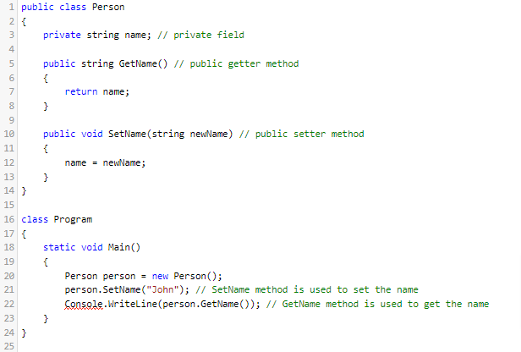
Encapsulation
Encapsulation is the bundling of data (attributes) and methods (behaviors) that operate on the data into a single unit (class). It hides the internal state of an object from the outside and only exposes a controlled interface for interacting with the object. This helps in data hiding and reduces the complexity of the system.
In this example, the name field is encapsulated within the Person class using the private access modifier. This means that the name field cannot be accessed directly from outside the Person class.
Instead, the public GetName and SetName methods are used to access and modify the name field, thereby encapsulating the internal state of the Person object.

Slide 16
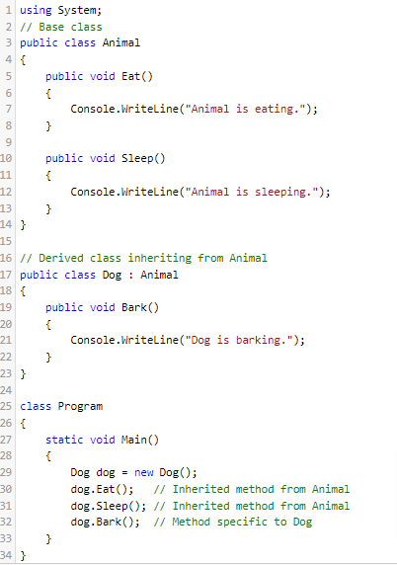
Inheritance
Inheritance is the mechanism by which a new class (derived class or subclass) is created from an existing class (base class or superclass). The derived class inherits the properties and behaviors of the base class and can also have its own additional properties and behaviors. This promotes code reusability and allows for creating a hierarchy of classes.
Syntax: class DerivedClassName : BaseClassName { }
Example: public class Student : Person { }

Slide 17
Polymorphism
Polymorphism means "many forms" and refers to the ability of objects to respond to the same message or method invocation in different ways. There are two types of polymorphism: compile-time polymorphism (method overloading) and runtime polymorphism (method overriding). Polymorphism allows for more flexible and dynamic code.
class BaseClass
{
public virtual void Display()
{
Console.WriteLine("Base class display method");
}
}
class DerivedClass : BaseClass
{
public override void Display()
{
Console.WriteLine("Derived class display method");
}
}

Slide 18
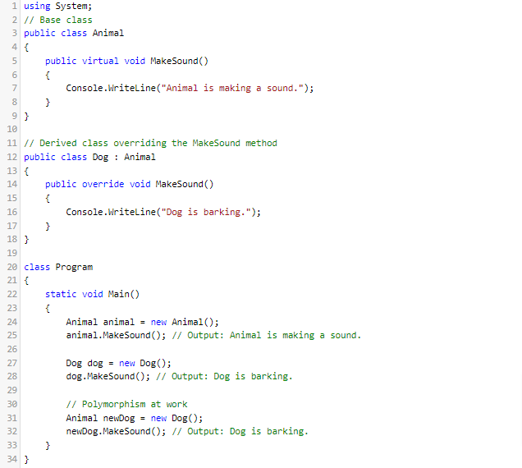
Polymorphism Example
In this example, the Dog class overrides the MakeSound method of the Animal class. When a Dog object is created and its MakeSound method is called, the overridden method in the Dog class is executed.
The last example demonstrates polymorphism, where a Dog object is assigned to an Animal reference, and the MakeSound method of the Dog class is still called at runtime.

Slide 19
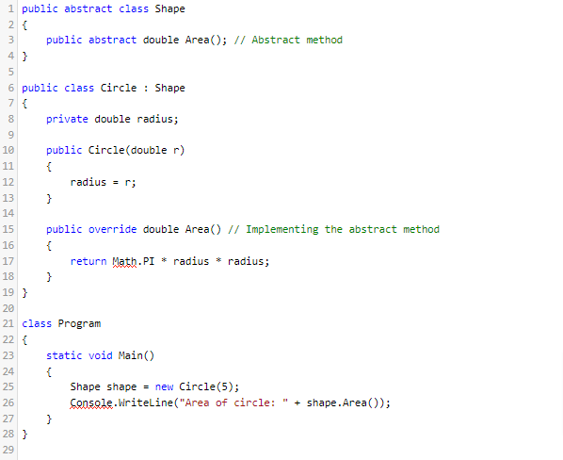
Abstraction
Abstraction is a fundamental concept in object-oriented programming (OOP) that focuses on hiding the implementation details of a class and only showing the essential features of an object. This helps in reducing complexity and simplifying the interface for interacting with objects.
In C#, abstraction is achieved using abstract classes and interfaces.
Abstract Class:
An abstract class is a class that cannot be instantiated and may contain abstract methods (methods without implementation) that must be implemented by derived classes.
In this example, Shape is an abstract class with an abstract method Area(). The Circle class derives from Shape and implements the Area() method, providing its own implementation for calculating the area of a circle.

Slide 20
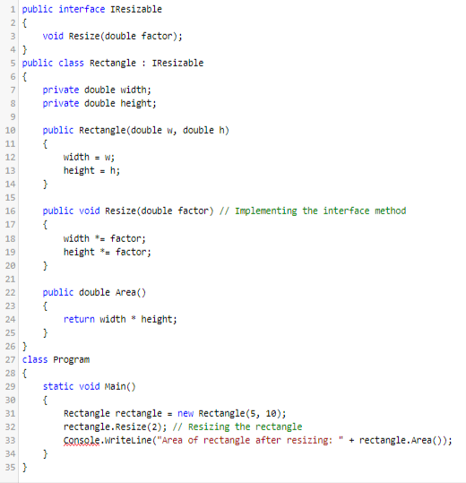
Abstraction
Interface:
An interface is a contract that defines a set of members (methods, properties, events, indexers) that implementing classes must provide.
In this example, IResizable is an interface with a method Resize(). The Rectangle class implements the IResizable interface and provides its own implementation for the Resize() method.

Slide 21
Questions?
Thank You

